Slide 1
Create a bar chart or histogram to visualize the distribution of a categorical or continuous variable, such as the distribution of ages or genders in a population.
import pandas as pd
Import matplotlib.pyplot as plt
# Sample data as a dictionarydata = { 'Person': [1, 2, 3, 4, 5, 6, 7, 8, 9, 10], 'Age': [25, 30, 22, 28, 35, 40, 19, 23, 31, 27], 'Gender': ['Male', 'Female', 'Female', 'Male', 'Female', 'Male', 'Female', 'Male', 'Female', 'Male’]}
# Convert the dictionary into a DataFramedf = pd.DataFrame(data)
# Display the first few rows of the DataFrameprint(df.head())
# Plotting the distribution of Ages using a Histogram
plt.figure(figsize=(10, 6))
plt.hist(df['Age'], bins=5, color='skyblue', edgecolor='black’)
plt.title('Age Distribution’)
plt.xlabel('Age’)
plt.ylabel('Frequency’)
plt.grid(axis='y', alpha=0.75)
plt.show()
# Plotting the distribution of Genders using a Bar Chartgender_counts = df['Gender'].value_counts()
plt.figure(figsize=(8, 5))
gender_counts.plot(kind='bar', color=['salmon', 'lightblue'], edgecolor='black’)
plt.title('Gender Distribution’)
plt.xlabel('Gender’)
plt.ylabel('Count’)
plt.xticks(rotation=0)
plt.grid(axis='y', alpha=0.75)
plt.show()

Slide 2
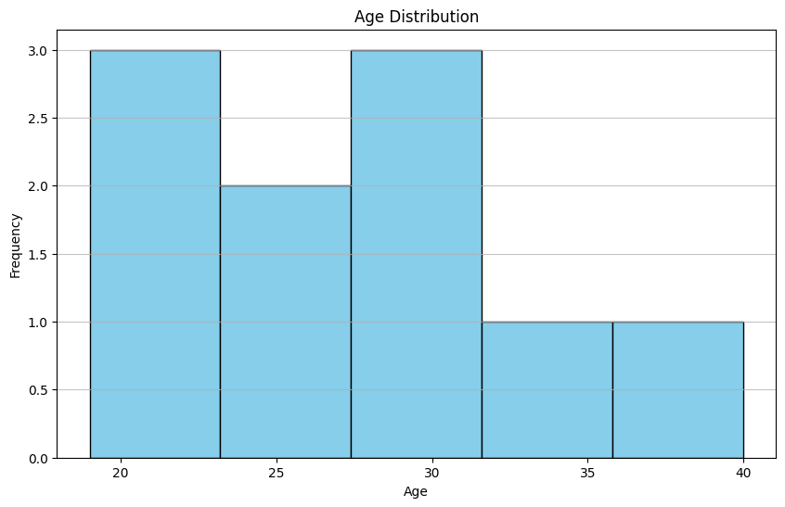
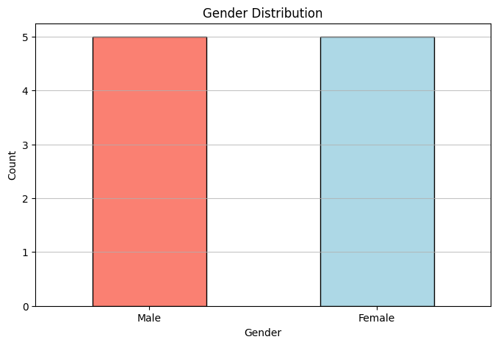
person age gender
1 25 male
2 30 female
3 22 female
4 28 male
5 35 female

